Slide 1
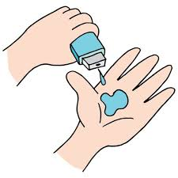
ANALYSIS OF SUPER STORE
ASWANTH.E

Slide 2

PROBLEM STATEMENT
The goal of the Superstore Analysis is to identify key trends and insights from sales, customer, and product data to improve decision-making and drive growth. Specifically, the analysis aims to uncover which product categories and regions generate the highest and lowest profits, understand seasonal and monthly sales trends, and identify customer segments contributing the most to revenue. By examining sales performance, discounts, and customer demographics, the analysis will help the Superstore optimize inventory, marketing strategies, and discount policies. Additionally, it will provide actionable recommendations for expanding profitable segments and managing underperforming areas. This analysis will ultimately guide the Superstore in enhancing profitability, improving customer satisfaction, and sustaining long-term growth.

Slide 3
Project Description
The Super Store data analysis project aims to uncover key insights into sales, profit trends, and customer behavior. The project involves cleaning and processing data, followed by performing exploratory data analysis (EDA) to identify top-performing categories and regions. Additionally, we will visualize sales distribution, profit margins, and seasonal trends to inform strategic business decisions. The analysis seeks to pinpoint areas for growth and cost optimization. The final report will provide actionable recommendations for enhancing store performance and profitability.

Slide 4

WHO ARE THE END USERS?
Store Management
Sales Teams
Marketing Teams
Regional Managers
Business Analysts
Executives

Slide 5

Technology Used
Python:
For data cleaning, processing, and analysis using libraries such as Pandas and NumPy.
Jupyter Notebook:
To create an interactive environment for data exploration and code documentation.
Matplotlib and Seaborn:
For creating detailed visualizations and charts to illustrate trends and insights.

Slide 6
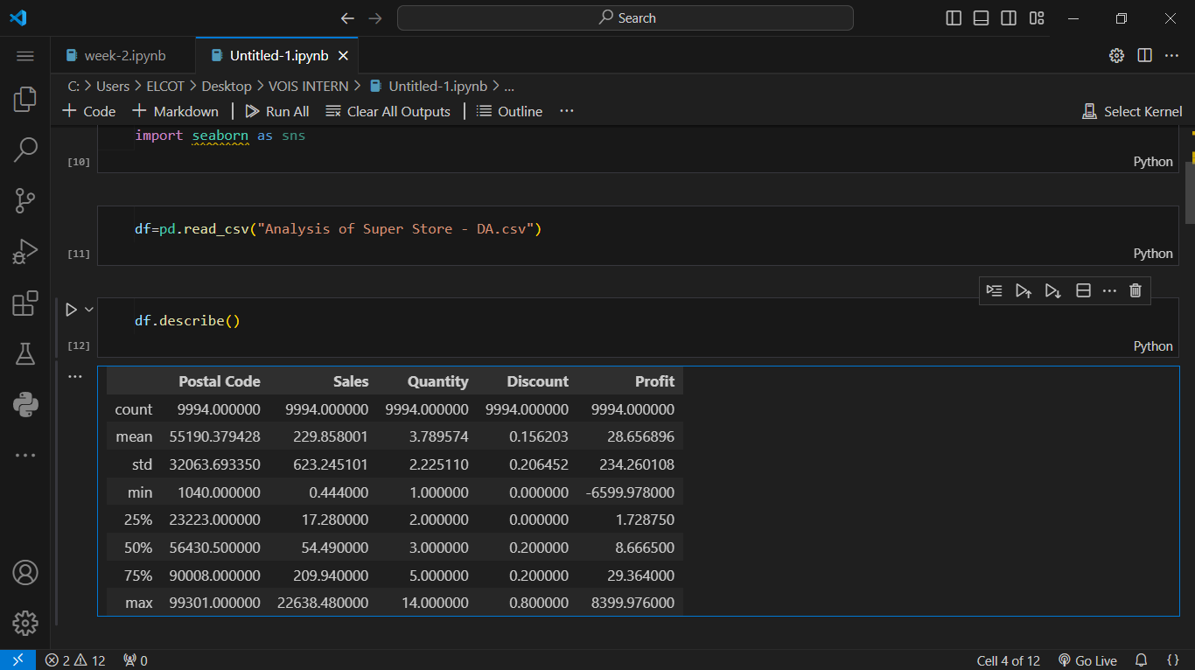
RESULTS
Demo Link

Slide 7
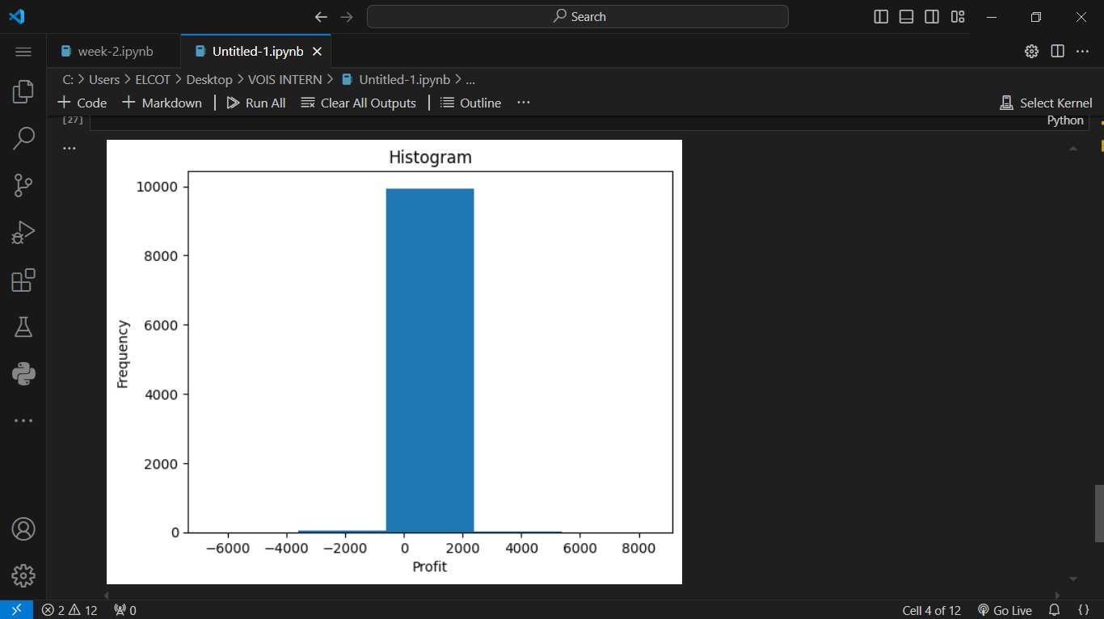
.
.

Slide 8
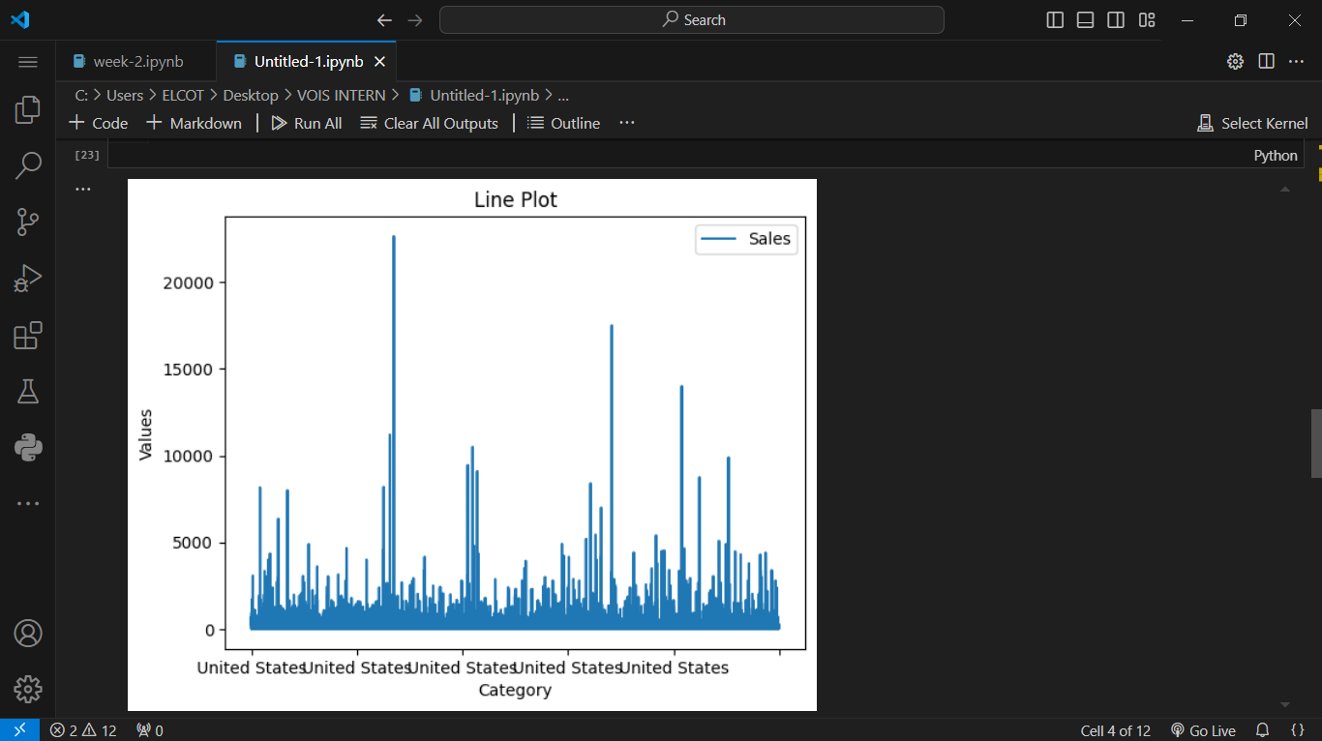
.
.

Slide 9
Thank you
.
.

